Slide 1


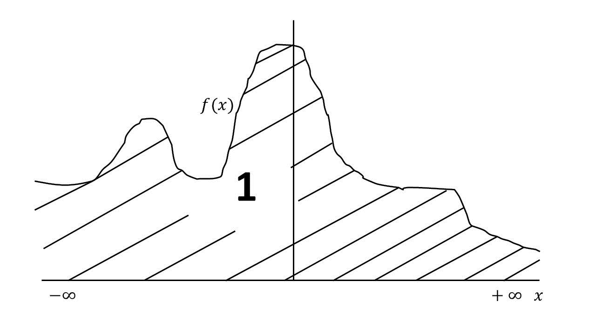
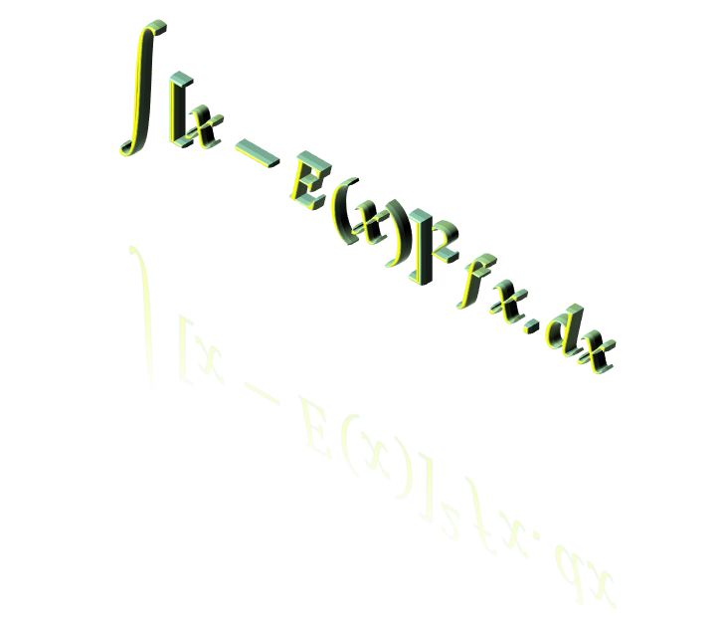

Regresion Lineal simple
$$\int{{\left[x−E(x)\right]}^{2}fx.dx}$$
Lic. Ezequiel Gutierrez
$$\sum{x∗p(x)}$$

Slide 2

REGRESION
El modelo de Regresion es una representación de la realidad para la estimación de una variable
Busca establecer si una variable depende de otras(Multiple)
Se busca una función$f(x_{1}; x_{2};…; x_{n})$ que explique el comportamiento de la variable
$y=f(x_{1},x_{2},…,x_{n})$ es el modelo a establecer
Existen muchas funciones diferentes para explicar y estimar la variable
Lo mas adecuado es establecer un modelo Lineal

Slide 3
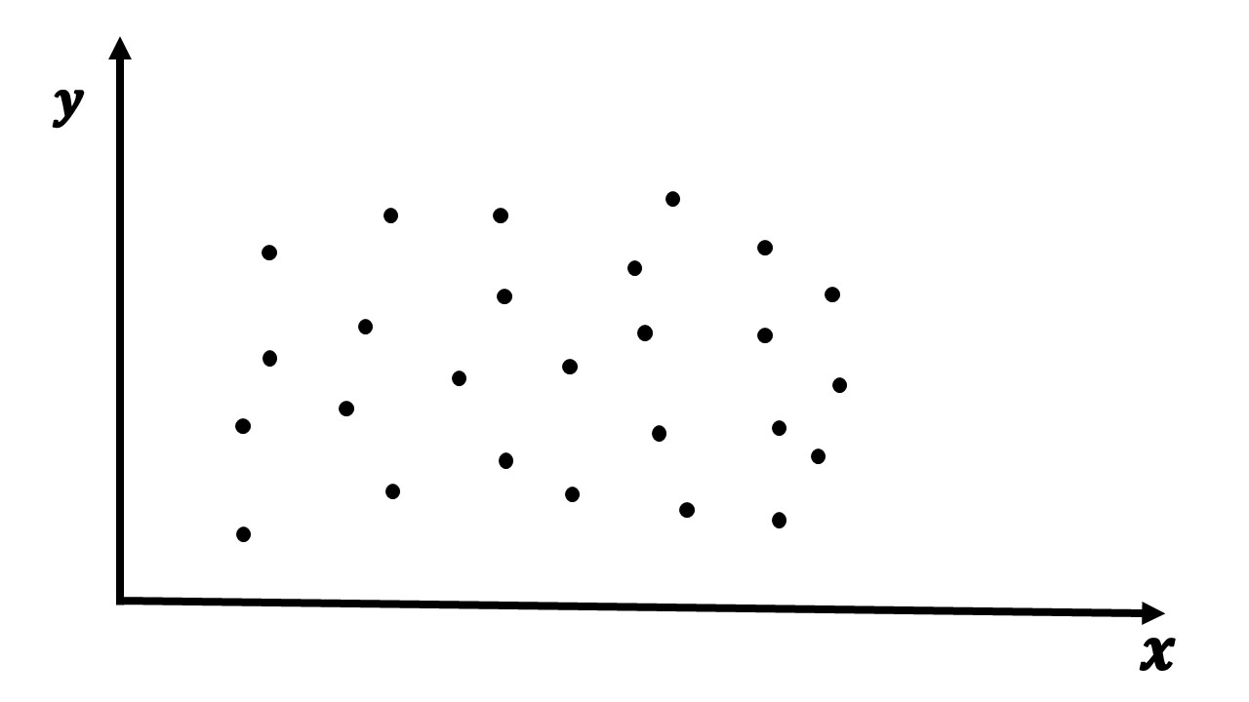
REGRESION
Supongamos que queremos analizar si las temperaturas$(x)$ infieren sobre las toneladas de trigo cosechadas$(y)$
GRAFICO DE DISPERSION
En este grafico no puede observarse si existe una relación entre las variables

Slide 4
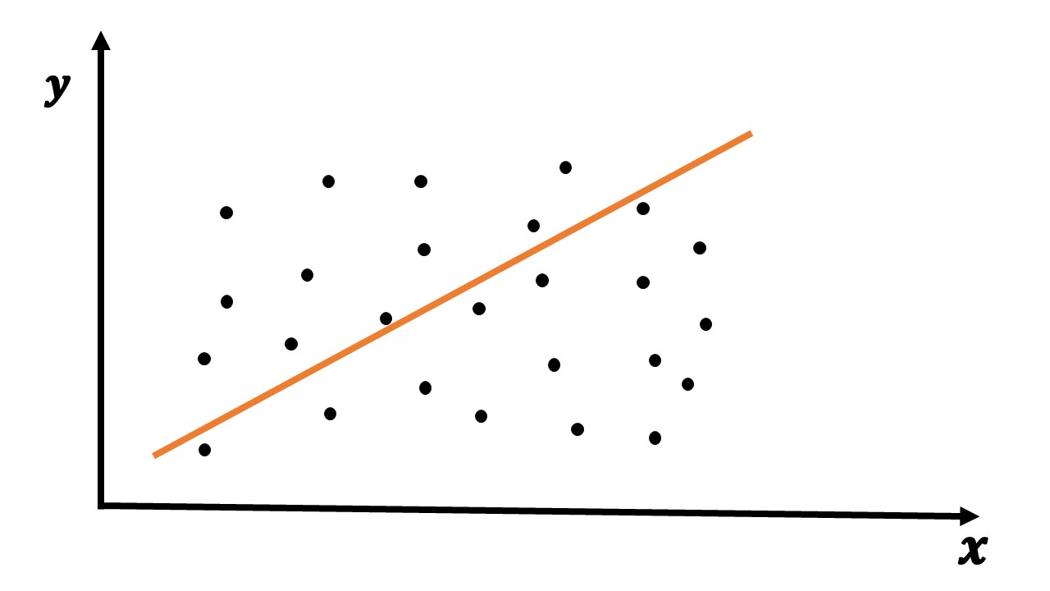
REGRESION LINEAL
El objetivo es hallar una recta que pueda establecer esa relacion

Slide 5
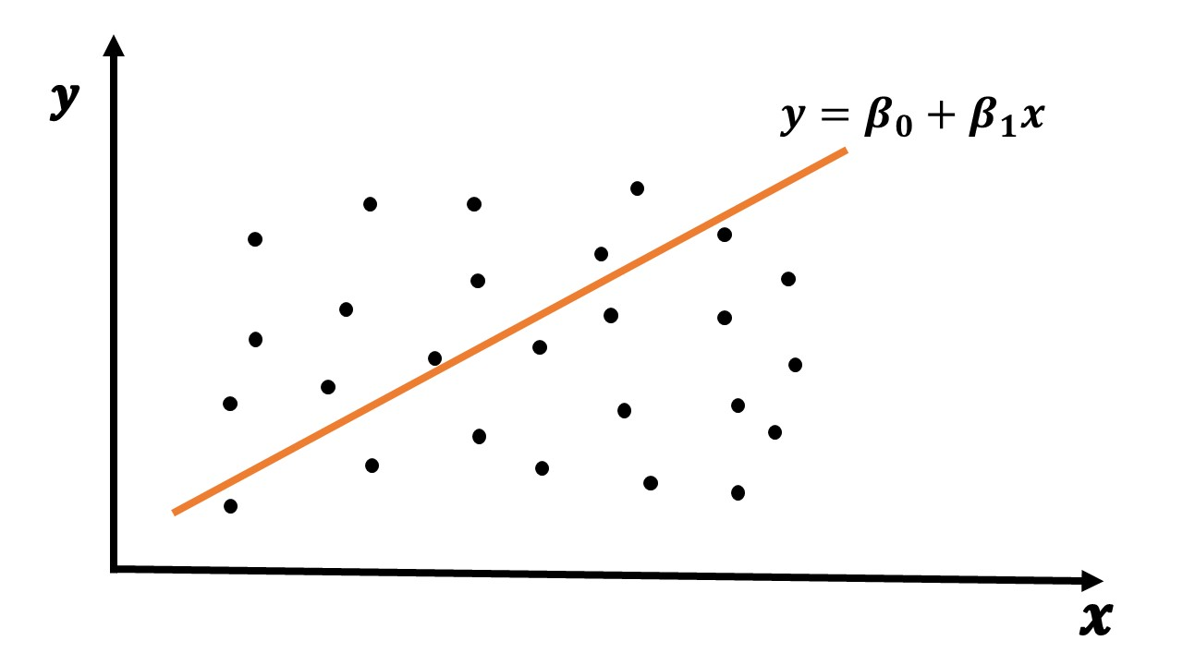

REGRESION LINEAL
$$y=β_{0}+β_{1}x$$

Slide 6

REGRESION LINEAL
$$Como es un modelo a estimar toma la siguiente forma→\hat{y}=β_{0}+β_{1}x$$

Slide 7
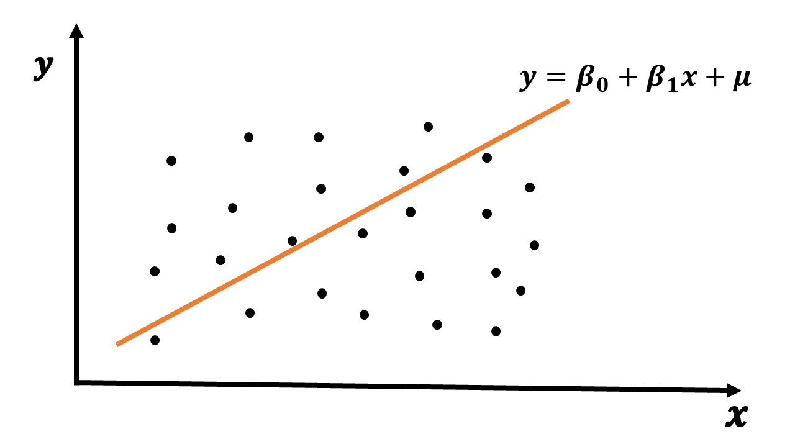

REGRESION LINEAL
El modelo no explica la relación al 100%
Contiene una parte no explicada$(μ)$
$μ$ es la parte aleatoria o estocástica del modelo, también conocido como residuo
$$y=β_{0}+β_{1}x+μ$$

Slide 8
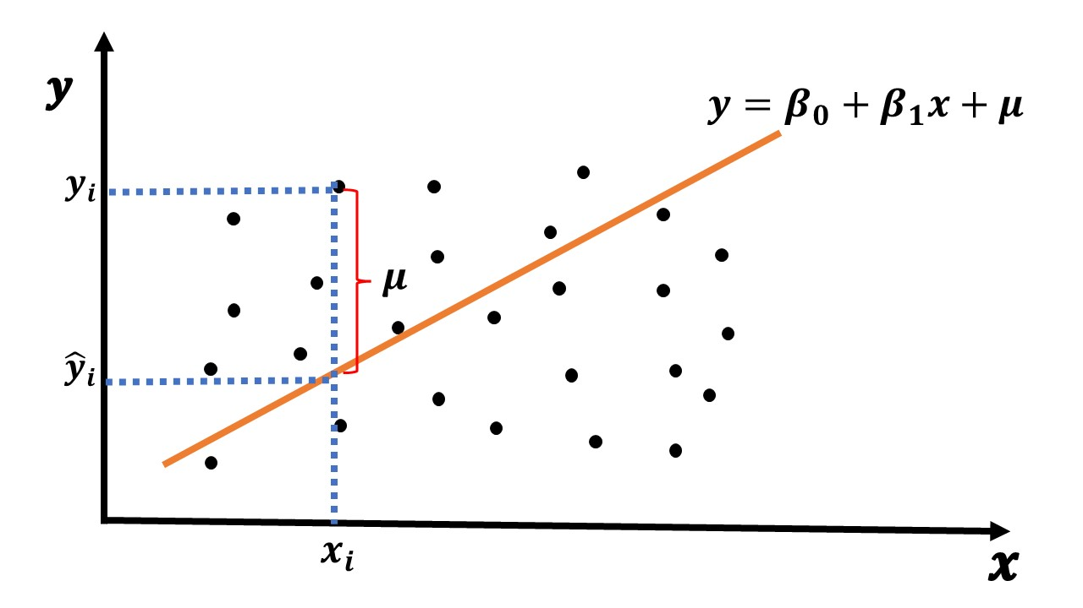






REGRESION LINEAL
El mejor modelo a estimar es aquel que minimiza la parte no explicada
$\sum{μ}=0$
El problema es que el modelo nace de dichos residuos
Se recurre al método de Minimos Cuadrados Ordinarios
$$Min \sum{μ^{2}=0}$$
$$Min \sum{{\left(y_{i}−{\hat{y}}_{i}\right)}^{2}=0}$$
$${\hat{y}}_{i}=β_{0}+β_{1}x_{i}$$
$$Min \sum{{\left(y_{i}−(β_{0}+β_{1}x_{i})\right)}^{2}=0}$$
$$Min \sum{{\left(y_{i}−β_{0}−β_{1}x_{i}\right)}^{2}=0}$$

Slide 9




$$Min \sum{{\left(y_{i}−β_{0}−β_{1}x_{i}\right)}^{2}=0}$$
$$Min {\left(y_{1}−β_{0}−β_{1}x_{1}\right)}^{2}+{\left(y_{2}−β_{0}−β_{1}x_{2}\right)}^{2}+…+{\left(y_{n}−β_{0}−β_{1}x_{n}\right)}^{2}=0$$
$$\frac{δ\sum{μ^{2}}}{δβ_{0}}=0$$
$$2\left(y_{1}−β_{0}−β_{1}x_{1}\right)\left(−1\right)+2\left(y_{2}−β_{0}−β_{1}x_{2}\right)\left(−1\right)+…+2\left(y_{n}−β_{0}−β_{1}x_{n}\right)\left(−1\right)=0$$
$$\left(−2\right)\left(y_{1}−β_{0}−β_{1}x_{1}+y_{2}−β_{0}−β_{1}x_{2}+…+y_{n}−β_{0}−β_{1}x_{n}\right)=0$$
$$y_{1}−β_{0}−β_{1}x_{1}+y_{2}−β_{0}−β_{1}x_{2}+…+y_{n}−β_{0}−β_{1}x_{n}=0$$
$$y_{1}+y_{2}+…+y_{n}−β_{0}−β_{0}−…−β_{0}−β_{1}x_{1}−β_{1}x_{2}−…−β_{1}x_{n}=0$$
$$\sum{y_{i}}−nβ_{0}−β_{1}\sum{x_{i}}=0$$
$$nβ_{0}+β_{1}\sum{x_{i}}=\sum{y_{i}}$$

Slide 10





$$nβ_{0}+β_{1}\sum{x_{i}}=\sum{y_{i}}$$
$$nβ_{0}=\sum{y_{i}−β_{1}\sum{x_{i}}}$$
$$β_{0}=\frac{\sum{y_{i}−β_{1}\sum{x_{i}}}}{n}$$
$$β_{0}=\sum{\frac{y_{i}}{n}−β_{1}\sum{\frac{x_{i}}{n}}}$$
$$β_{0}=\overline{Y}−β_{1}\overline{X}$$

Slide 11



$$Min \sum{{\left(y_{i}−β_{0}−β_{1}x_{i}\right)}^{2}=0}$$
$$Min {\left(y_{1}−β_{0}−β_{1}x_{1}\right)}^{2}+{\left(y_{2}−β_{0}−β_{1}x_{2}\right)}^{2}+…+{\left(y_{n}−β_{0}−β_{1}x_{n}\right)}^{2}=0$$
$$\frac{δ\sum{μ^{2}}}{δβ_{1}}=0$$
$$2\left(y_{1}−β_{0}−β_{1}x_{1}\right)\left(−x_{1}\right)+2\left(y_{2}−β_{0}−β_{1}x_{2}\right)\left(−x_{2}\right)+…+2\left(y_{n}−β_{0}−β_{1}x_{n}\right)\left(−x_{n}\right)=0$$
$$(−2)\left(y_{1}x_{1}−β_{0}x_{1}−β_{1}x_{1}^{2}+y_{2}x_{2}−β_{0}x_{2}−β_{1}x_{2}^{2}+…+y_{n}x_{n}−β_{0}x_{n}−β_{1}x_{n}^{2}\right)=0$$
$$y_{1}x_{1}−β_{0}x_{1}−β_{1}x_{1}^{2}+y_{2}x_{2}−β_{0}x_{2}−β_{1}x_{2}^{2}+…+y_{n}x_{n}−β_{0}x_{n}−β_{1}x_{n}^{2}=0$$
$$y_{1}x_{1}+y_{2}x_{2}+…+y_{n}x_{n}−β_{0}x_{1}−β_{0}x_{2}−…−β_{0}x_{n}−β_{1}x_{1}^{2}−β_{1}x_{2}^{2}−…−β_{1}x_{n}^{2}=0$$
$$\sum{y_{i}x_{i}}−β_{0}\sum{x_{i}}−β_{1}\sum{x_{i}^{2}}=0$$
$$β_{0}\sum{x_{i}}+β_{1}\sum{x_{i}^{2}}=\sum{y_{i}x_{i}}$$

Slide 12



$$\left\{\begin{aligned}nβ_{0}+β_{1}\sum{x_{i}}=\sum{y_{i}} \\ β_{0}\sum{x_{i}}+β_{1}\sum{x_{i}^{2}}=\sum{y_{i}x_{i}}\end{aligned}\right.$$
$$β_{1}=\frac{\left|{n \atop \sum{x_{i}}}\right. \left.{\sum{y_{i}} \atop \sum{y_{i}x_{i}}}\right|}{\left|{n \atop \sum{x_{i}}}\right. \left.{\sum{x_{i}} \atop \sum{x_{i}^{2}}}\right|}$$
$$β_{1}=\frac{n\sum{y_{i}x_{i}}−\sum{x_{i}}\sum{y_{i}}}{n\sum{x_{i}^{2}}−{\left(\sum{x_{i}}\right)}^{2}}$$

Slide 13






$$β_{1}=\frac{n\sum{y_{i}x_{i}}−\sum{x_{i}}\sum{y_{i}}}{n\sum{x_{i}^{2}}−{\left(\sum{x_{i}}\right)}^{2}}$$
$$β_{1}=\frac{\frac{\sum{y_{i}x_{i}}}{n}−\overline{X}\overline{Y}}{\frac{\sum{x_{i}^{2}}}{n}−{\left(\overline{X}\right)}^{2}}$$
$$β_{1}=\frac{\left(n\sum{y_{i}x_{i}}−\sum{x_{i}}\sum{y_{i}}\right)∗(\frac{1}{n^{2}})}{\left(n\sum{x_{i}^{2}}−{\left(\sum{x_{i}}\right)}^{2}\right)∗(\frac{1}{n^{2}})}$$
$$β_{1}=\frac{\frac{n\sum{y_{i}x_{i}}}{n^{2}}−\frac{\sum{x_{i}}\sum{y_{i}}}{n^{2}}}{\frac{n\sum{x_{i}^{2}}}{n^{2}}−\frac{{\left(\sum{x_{i}}\right)}^{2}}{n^{2}}}$$
$$β_{1}=\frac{\frac{\sum{y_{i}x_{i}}}{n}−\frac{\sum{x_{i}}}{n}∗\frac{\sum{y_{i}}}{n}}{\frac{\sum{x_{i}^{2}}}{n}−{\left(\frac{\sum{x_{i}}}{n}\right)}^{2}}$$
$$β_{1}=\frac{COV(x,y)}{S_{x}^{2}}$$

Slide 14
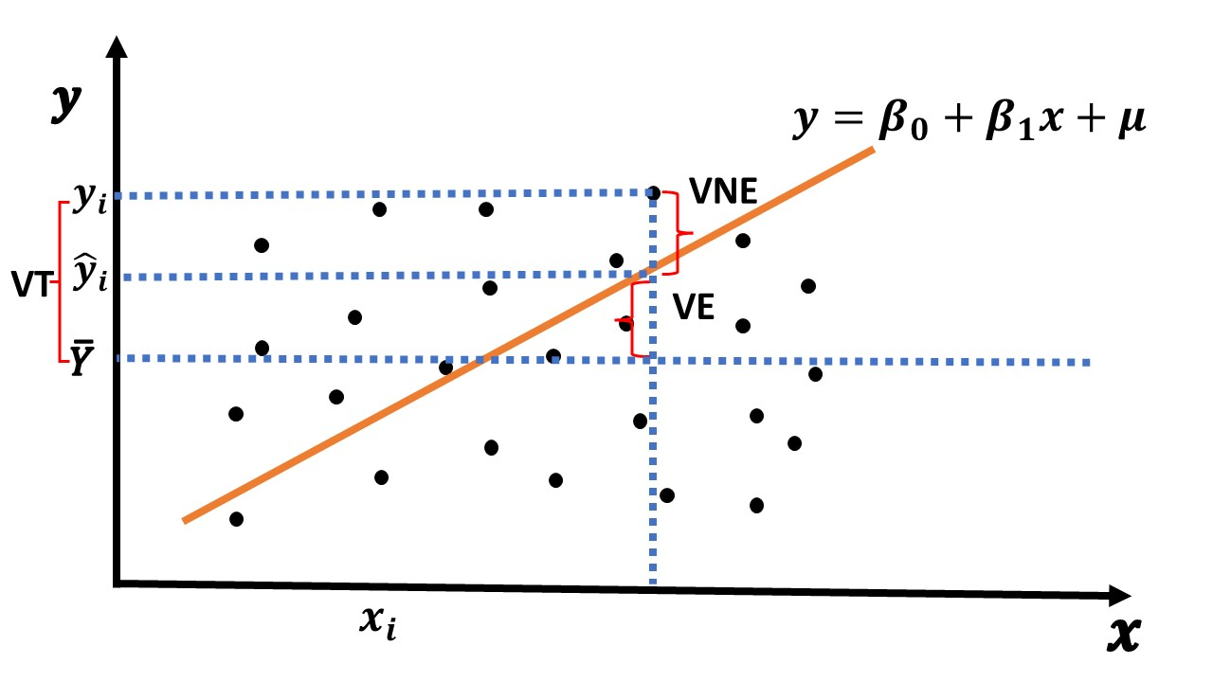

COEFICIENTE DE DETERMINACION
Una vez establecido el modelo que minimiza los residuos debemos ponerlo a prueba para saber que tan bueno es
Coeficiente de determinación $R^{2}$ o $ρ^{2}$ nos determina en que porcentaje el modelo explica la relación

Slide 15








COEFICIENTE DE DETERMINACION
$$VE=\sum{{\left({\hat{y}}_{i}−\overline{Y}\right)}^{2}}$$
$$VNE=\sum{{\left(y_{i}−{\hat{y}}_{i}\right)}^{2}}$$
$$VT=\sum{{\left(y_{i}−\overline{Y}\right)}^{2}}$$
$$VE+VNE=VT$$
$$R^{2}=\frac{VE}{VT}=\frac{\sum{{\left({\hat{y}}_{i}−\overline{Y}\right)}^{2}}}{\sum{{\left(y_{i}−\overline{Y}\right)}^{2}}}$$
$$R^{2}=1−\frac{VNE}{VT}=1−\frac{\sum{{\left(y_{i}−{\hat{y}}_{i}\right)}^{2}}}{\sum{{\left(y_{i}−\overline{Y}\right)}^{2}}}$$
$$si R^{2}→0 El modelo no es bueno$$
$${0≤R}^{2}≤1$$
$$si R^{2}→1 El modelo es bueno$$

Slide 16


COEFICIENTE DE CORRELACION
El coeficiente de correlación o de “Pearson”, $"r“$ o $"ρ“$ nos permite conocer el grado de relación existente entre las variables
$$r=\frac{\frac{\sum{x_{i}y_{i}}}{n}−\overline{X}\overline{Y}}{\sqrt{\frac{\sum{x_{i}^{2}}}{n}−{\overline{X}}^{2}}\sqrt{\frac{\sum{y_{i}^{2}}}{n}−{\overline{Y}}^{2}}}$$
$$r=\frac{COV(x,y)}{S_{x}S_{y}}$$

Slide 17









COEFICIENTE DE CORRELACION
$$r=\frac{\frac{\sum{x_{i}y_{i}}}{n}−\overline{X}\overline{Y}}{\sqrt{\frac{\sum{x_{i}^{2}}}{n}−{\overline{X}}^{2}}\sqrt{\frac{\sum{y_{i}^{2}}}{n}−{\overline{Y}}^{2}}}=$$
$$\frac{\frac{n\sum{x_{i}y_{i}}}{n^{2}}−\frac{\sum{x_{i}}}{n}\frac{\sum{y_{i}}}{n}}{\sqrt{\frac{n\sum{x_{i}^{2}}}{n^{2}}−{\left(\frac{\sum{x_{i}}}{n}\right)}^{2}}\sqrt{\frac{n\sum{y_{i}^{2}}}{n^{2}}−{\left(\frac{\sum{y_{i}}}{n}\right)}^{2}}}=$$
$$\frac{\frac{n\sum{x_{i}y_{i}}}{n^{2}}−\frac{\sum{x_{i}}\sum{y_{i}}}{n^{2}}}{\sqrt{\frac{n\sum{x_{i}^{2}}}{n^{2}}−\frac{{\left(\sum{x_{i}}\right)}^{2}}{n^{2}}}\sqrt{\frac{n\sum{y_{i}^{2}}}{n^{2}}−\frac{{\left(\sum{y_{i}}\right)}^{2}}{n^{2}}}}=$$
$$\frac{\frac{1}{n^{2}}(n\sum{x_{i}y_{i}}−\sum{x_{i}}\sum{y_{i}})}{\sqrt{\frac{1}{n^{2}}(n\sum{x_{i}^{2}}−{\left(\sum{x_{i}}\right)}^{2})}\sqrt{\frac{1}{n^{2}}(n\sum{y_{i}^{2}}−{\left(\sum{y_{i}}\right)}^{2})}}=$$
$$\frac{\frac{1}{n^{2}}(n\sum{x_{i}y_{i}}−\sum{x_{i}}\sum{y_{i}})}{\sqrt{\frac{1}{n^{2}}}\sqrt{ (n\sum{x_{i}^{2}}−{\left(\sum{x_{i}}\right)}^{2})}\sqrt{\frac{1}{n^{2}}}\sqrt{ (n\sum{y_{i}^{2}}−{\left(\sum{y_{i}}\right)}^{2})}}=$$
$$\frac{\frac{1}{n^{2}}(n\sum{x_{i}y_{i}}−\sum{x_{i}}\sum{y_{i}})}{\frac{1}{n}\sqrt{ (n\sum{x_{i}^{2}}−{\left(\sum{x_{i}}\right)}^{2})}\frac{1}{n}\sqrt{ (n\sum{y_{i}^{2}}−{\left(\sum{y_{i}}\right)}^{2})}}=$$
$$\frac{\frac{1}{n^{2}}(n\sum{x_{i}y_{i}}−\sum{x_{i}}\sum{y_{i}})}{\frac{1}{n^{2}}\sqrt{ (n\sum{x_{i}^{2}}−{\left(\sum{x_{i}}\right)}^{2})}\sqrt{ (n\sum{y_{i}^{2}}−{\left(\sum{y_{i}}\right)}^{2})}}=$$
$$r=\frac{ n\sum{x_{i}y_{i}}−\sum{x_{i}}\sum{y_{i}}}{\sqrt{\left(n\sum{x_{i}^{2}}−{\left(\sum{x_{i}}\right)}^{2}\right) (n\sum{y_{i}^{2}}−{\left(\sum{y_{i}}\right)}^{2})}}$$
$$si \left|r\right|→1 Las varibles tienen relacion fuerte$$
$$−1≤r≤1$$
$$si \left|r\right|→0 Las varibles tienen relacion debil$$
$$si r=0 Las varibles no tienen relacion$$

Slide 18
BIBLIOGRAFÍA
Bachini, D.; Vázquez, L.; Bianco, M. J.; García Fronti, J. (2018), Introducción a la probabilidad y estadística, Buenos Aires, CMA-FCE-UBA
Canavos, G. (1984), Probabilidad y estadística, aplicaciones y métodos, México, Mc Graw-Hill

Slide 19

MUCHAS GRACIAS!!!!!!!

